Slide 1
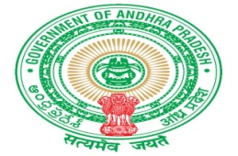
Government of Andhra Pradesh
Groundwater and Water Audit Department
MINISTRY OF WATER RESOURCES
Real Time Groundwater
and other Water Resources Monitoring
for Real Time Governance

Slide 2
Government of Andhra Pradesh
Ground Water and Water Audit Department
for
Realistic assessment of resource
Planning
Management
Sustainable development of water resources
Measure
Monitor
Map
Manage Water

Slide 3
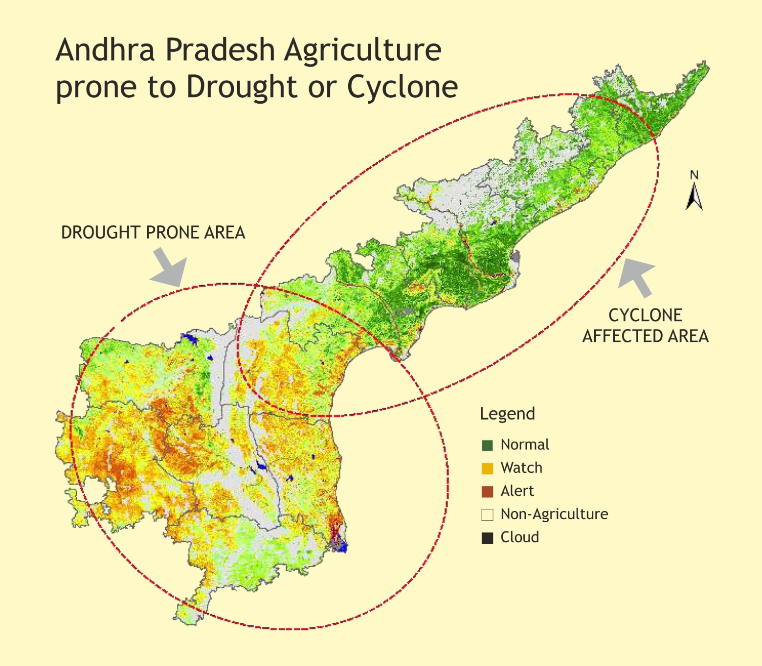

Slide 4
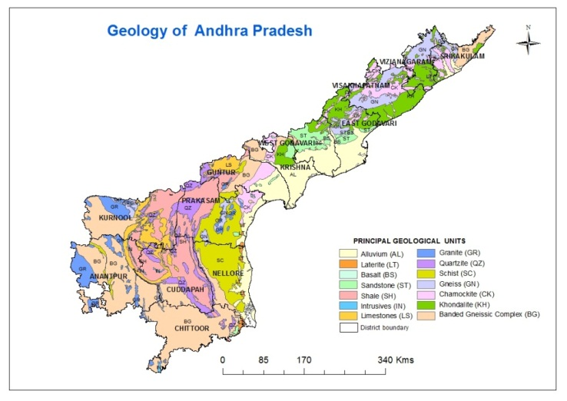
REAL TIME GROUNDWATER LEVELS MONITORING
PIEZOMETERS: 1254, MONITORING INTERVAL: 1 Hr.
Gw Micro basins: 748, Major Geological formations:14
VISION: ENSURE WATER LEVELS LESS THAN 8M. IN
PRE-MONSOON AND 3M. IN POST MONSON
Principal Geological Units in Andhra Pradesh
S. No. | Major Geological Unit | % of area in total State's area
1 | Alluvium | 12.75
2 | Laterite | 0.43
3 | Basalt | 0.09
4 | Sandstone | 2.80
5 | Shale | 12.47
6 | Limestone | 4.74
7 | Granite | 4.45
8 | Schist | 8.66
Principal Geological Units in Andhra Pradesh
S. No. | Major Geological Unit | % of area in total State's area
9 | Quartzite | 5.91
10 | Charnockite | 6.81
11 | Khondalite | 8.71
12 | Banded Granite Gneiss | 25.84
13 | Gneiss | 6.11
14 | Intrusives | 0.24
Out of the 1,63,120 Sq.Kms of Andhra Pradesh State area, about 20% of the area occupied by Soft Rocks (Sedimentary and Alluvium formation and the remaining 80% of the area is occupied by hard rocks (Compact geological formations)

Slide 5
Measure, Monitor, Map and Manage Water – for sustainability, effective utilization, drought proofing
World Class Gauging Network for Half – hourly monitoring
Automatic Weather Stations
Automatic Rain Gauges
River and Reservoir Water Level Recorders
Ground Water Level Recorders
Map and Dissemination to Manage
High Resolution spatial maps on weather parameters
Surface and Ground Water status maps
Real Time Information to Managers
State of the Art Early Warning System
Forewarning for Cyclone, Floods 48 – 72 hours in advance
Fortnightly Forewarning for Drought
Vulnerability Mapping
Mandal level for all intensities of Cyclones and Floods completed
Planning village level with Drone / LiDAR based high resolution topographic data
Web Based Digital data Dissemination
Dissemination of analyzed reports on real time / near real time in public domain
Collaboration and Knowledge Management
MoA with eWater Ltd., Government of Australia ; MoUs with IITs, IISc, IMD, NRSC

Slide 6
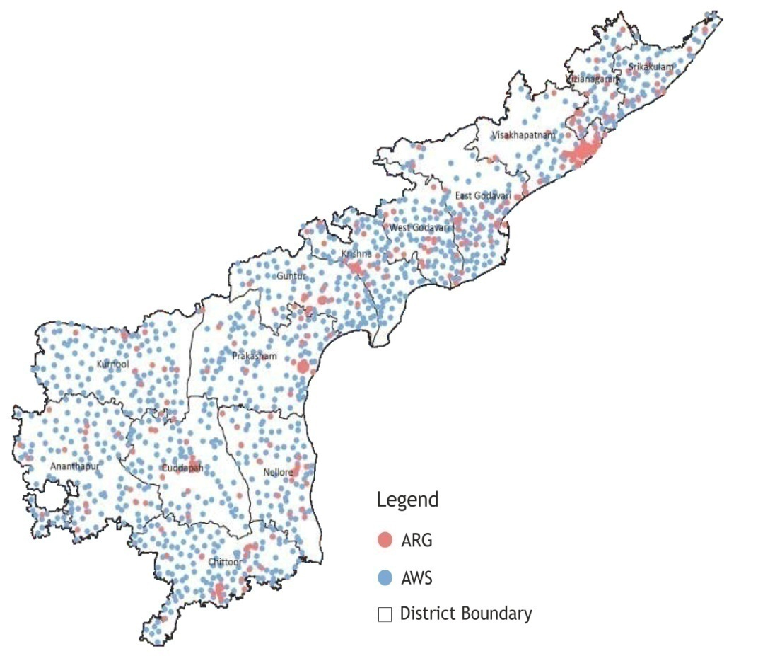
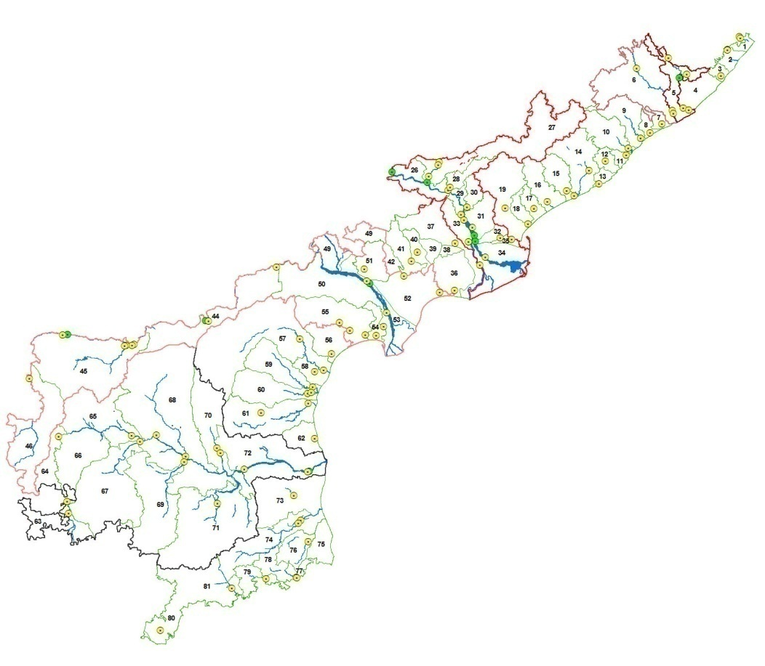
World Class Gauging Network for Half – hourly monitoring

Slide 7
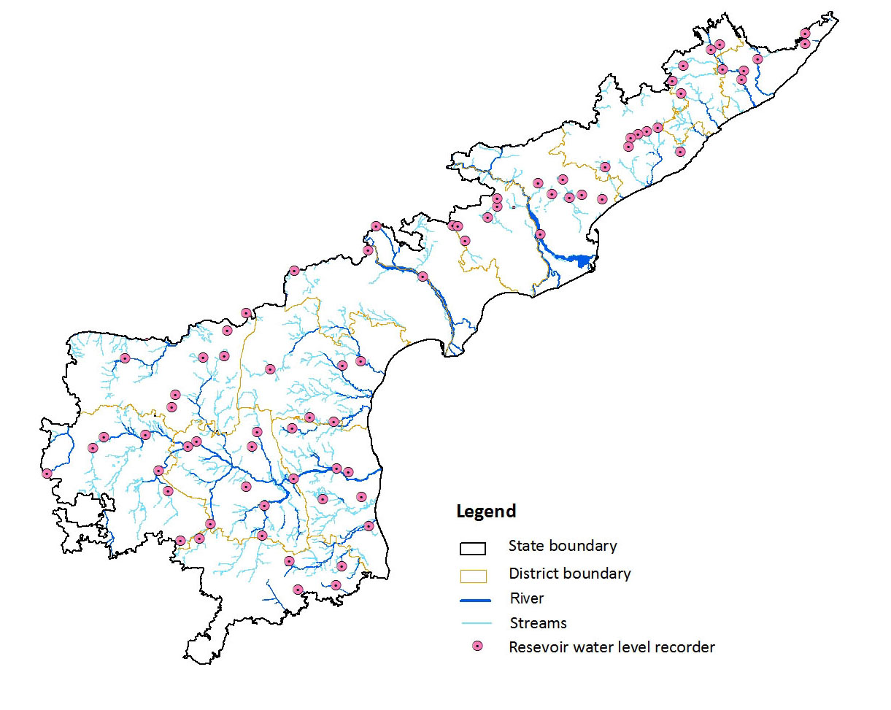
1254 Real Time Automatic Piezometers -Monitor Ground Water Stress and Poor Quality Areas.
76 Reservoir Level Recorders for Monitoring Reservoir Water Levels - for Efficient Water Management

Slide 8
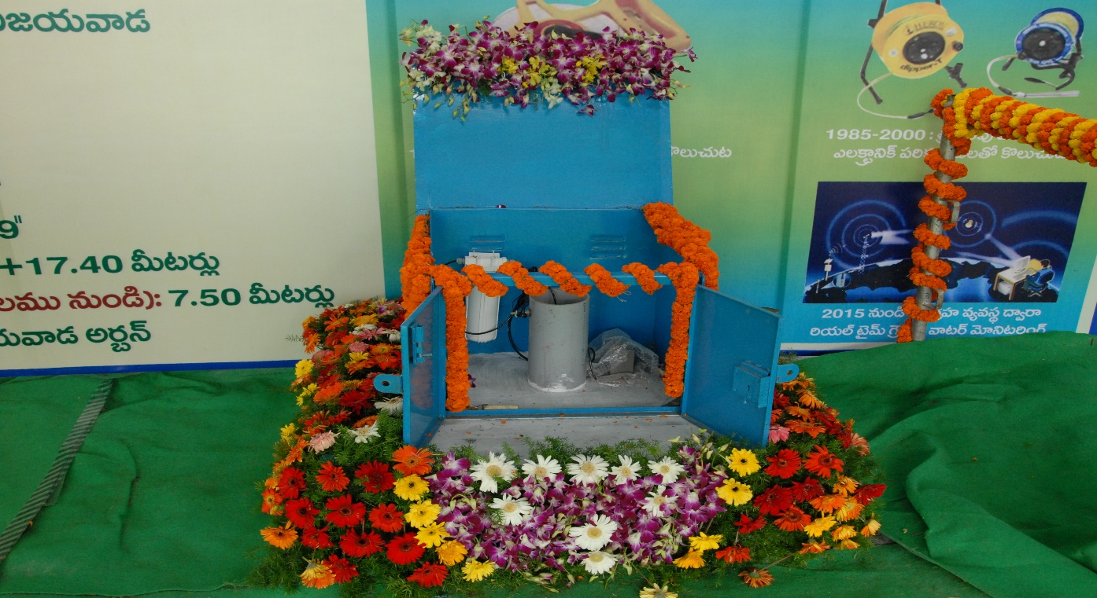
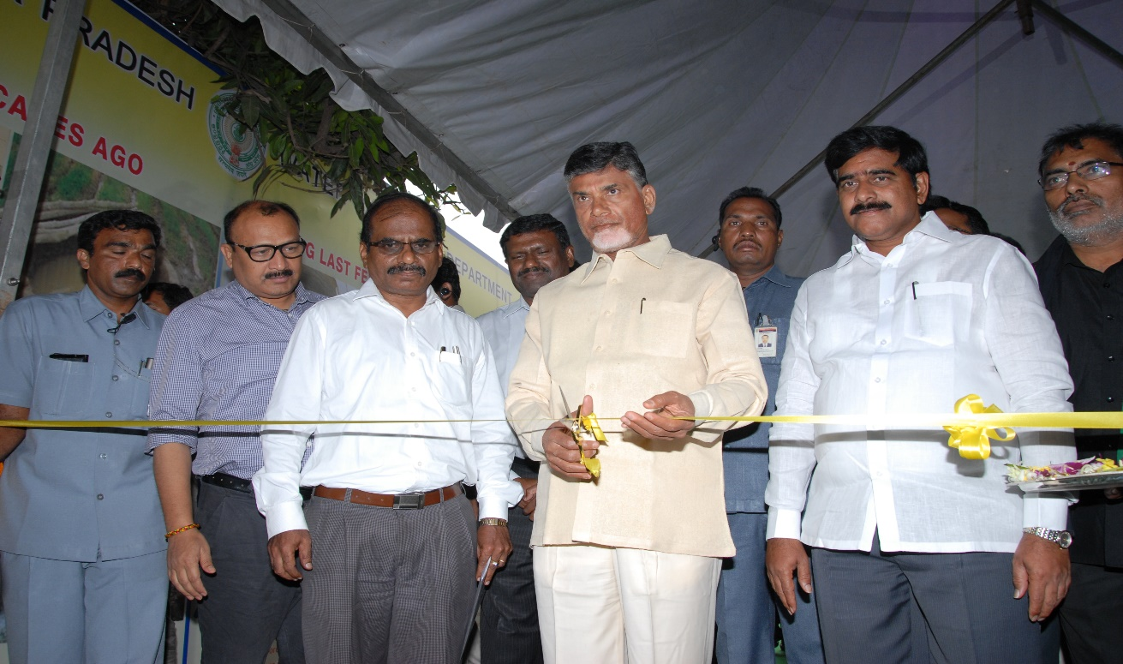
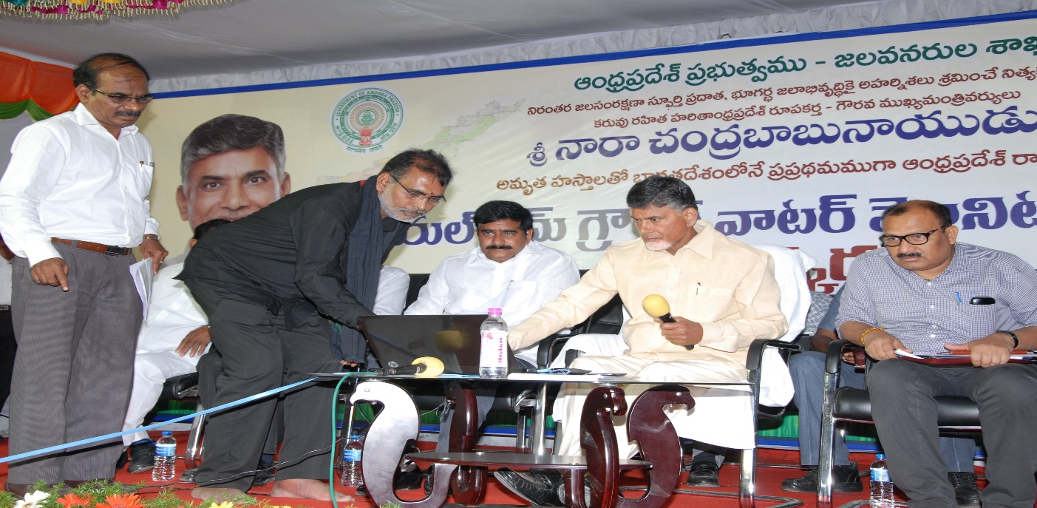
REAL TIME GROUNDWATER MONITORING IN ANDHRA PRADESH
PIEZOMETER MONITORING NETWORK
INAUGURATION OF REAL TIME GW MONITORING SYSTEM By Hon’ble Chief Minister of Andhra Pradesh
Sri N.CHANDRA BABU NAIDU

Slide 9
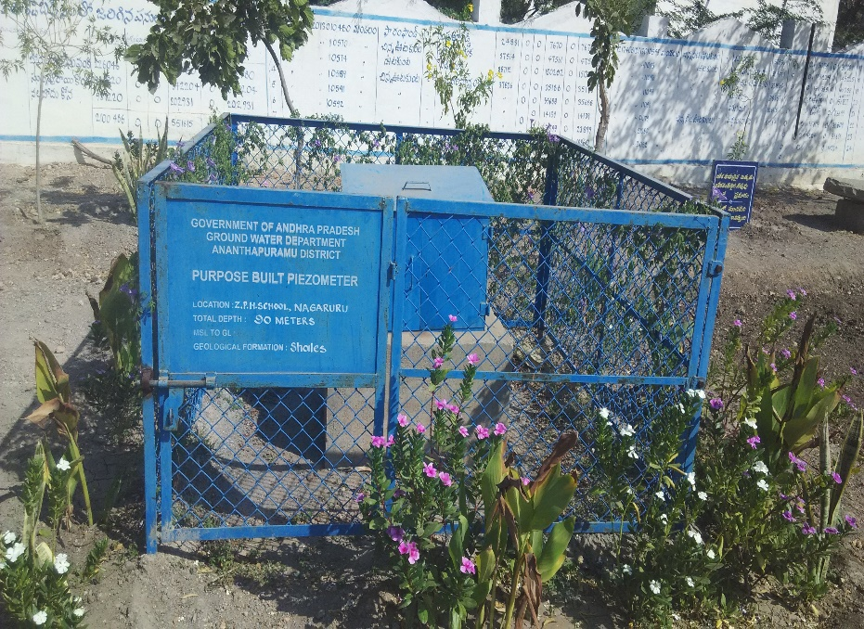
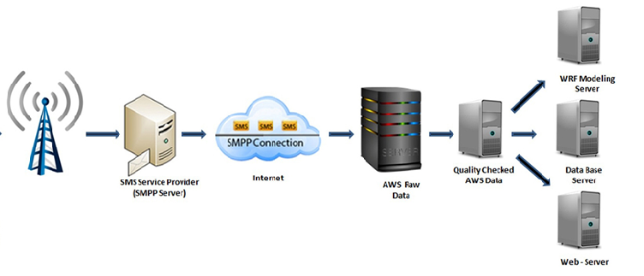
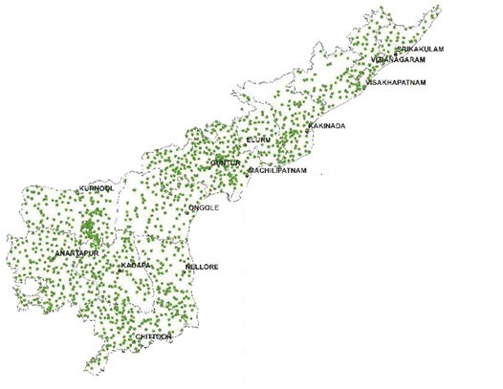
Groundwater Levels Data Flow
Piezometer’ Raw Data

Slide 10
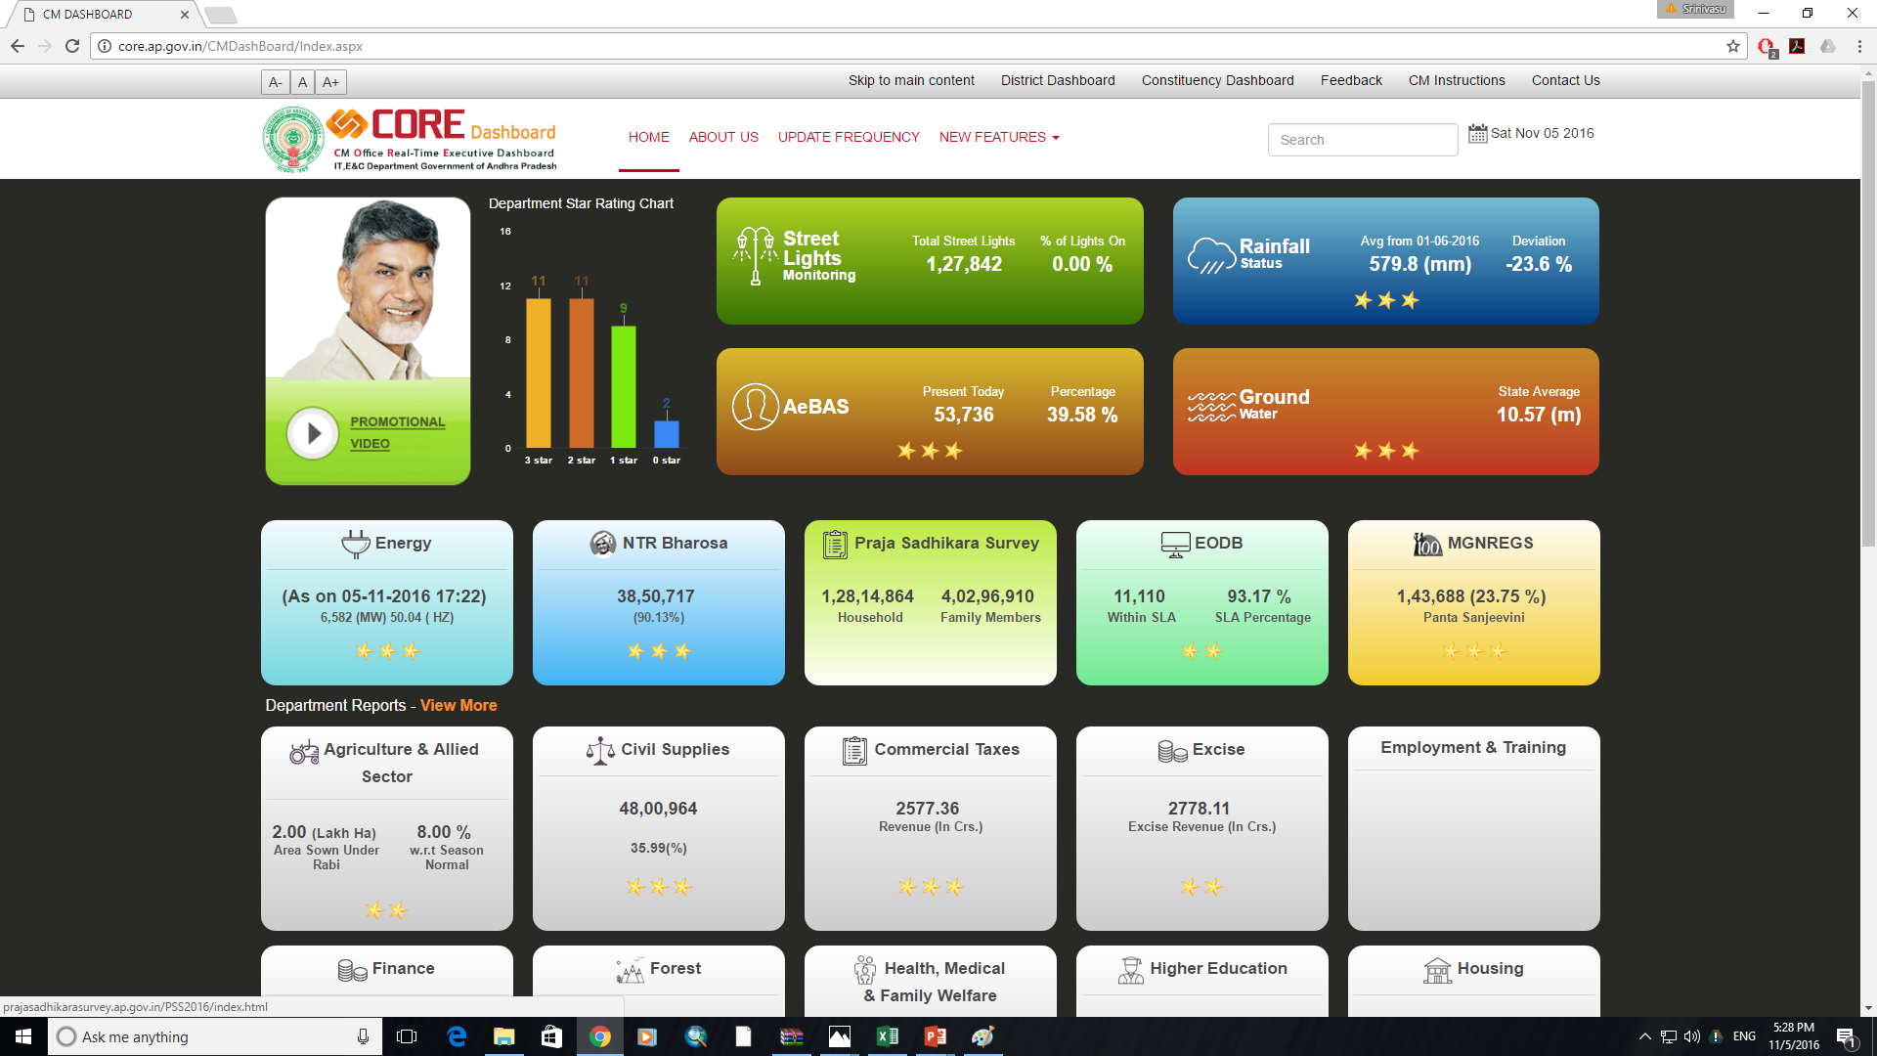
www.core.ap.gov.in
Data dissemination

Slide 11
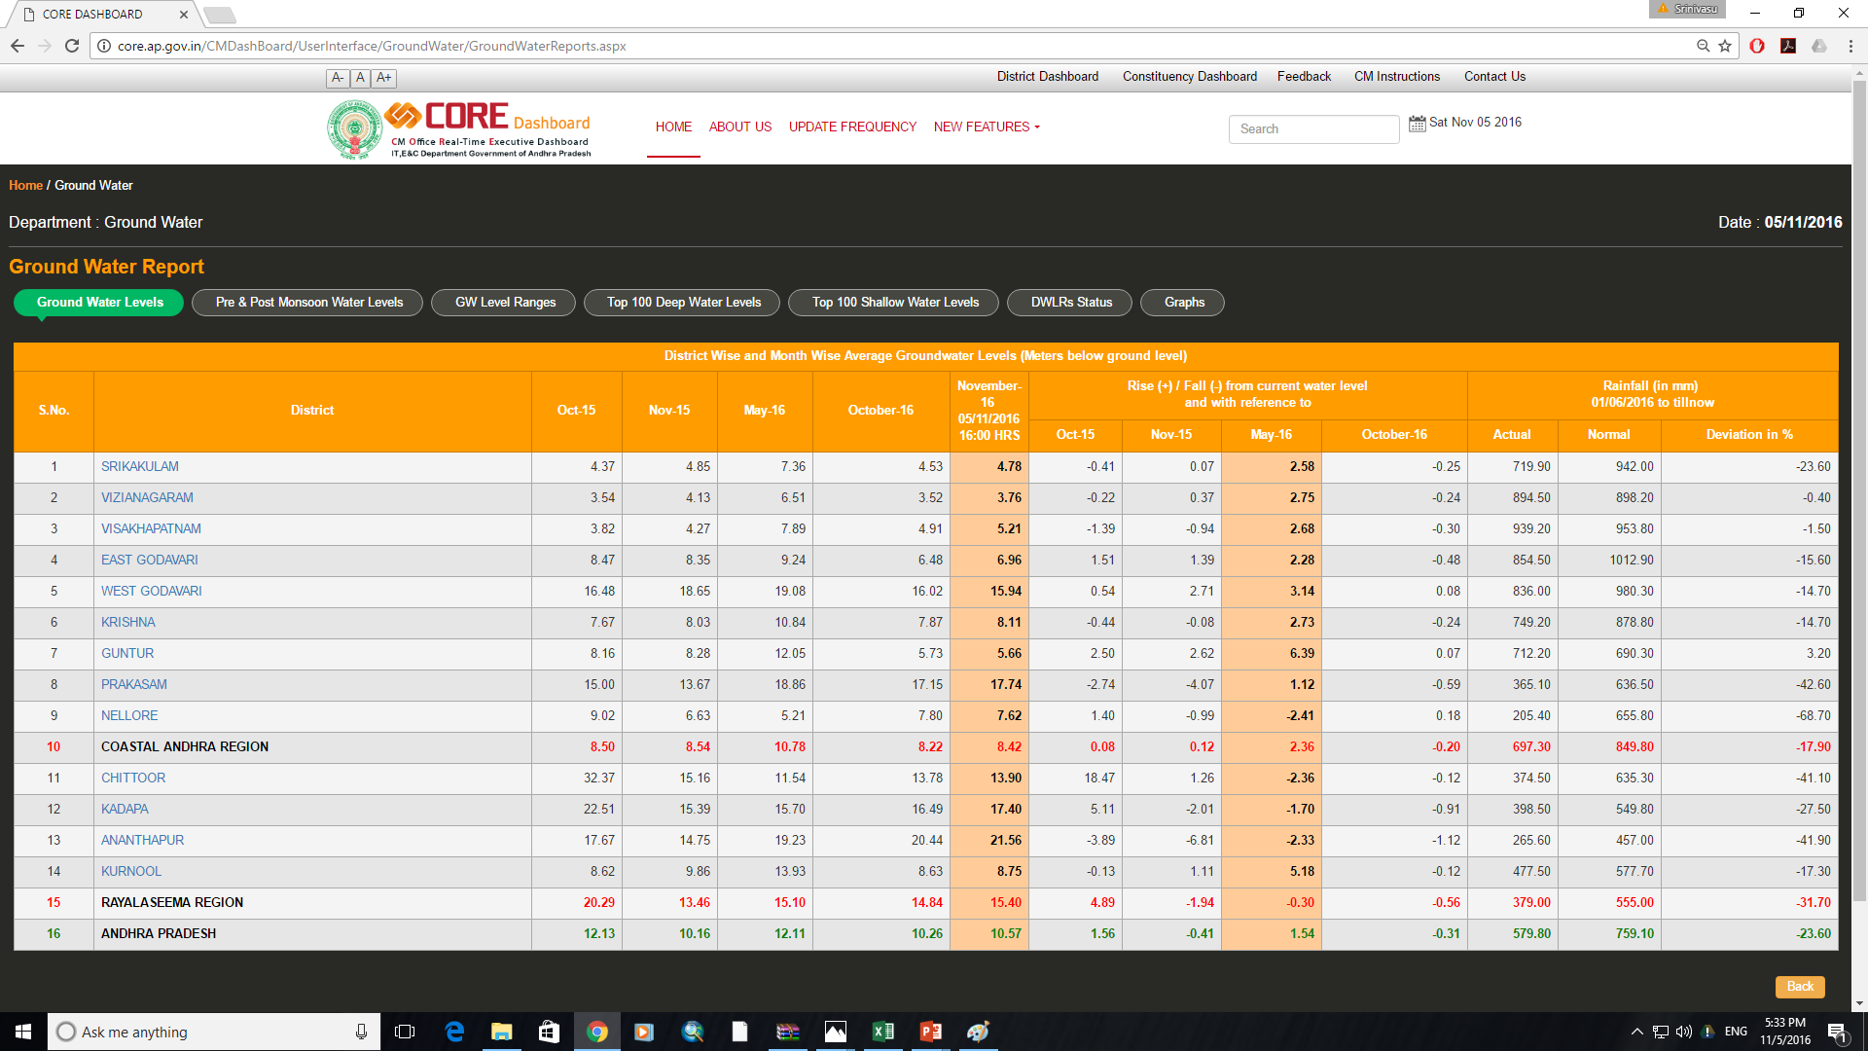

Slide 12
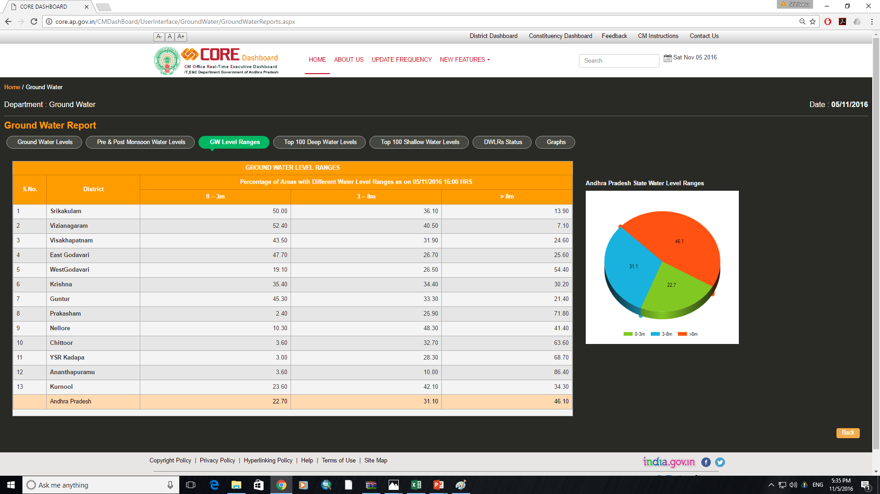

Slide 13
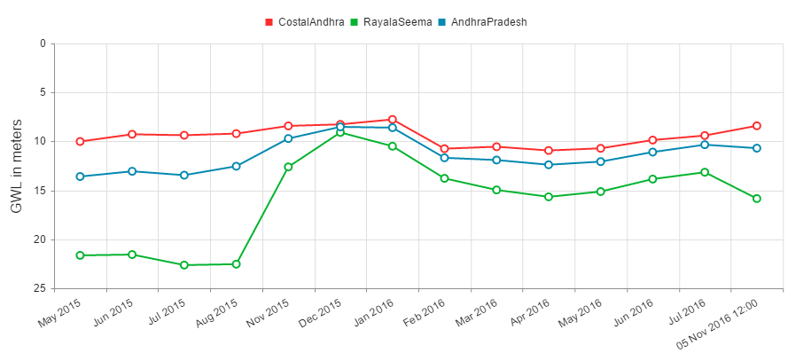
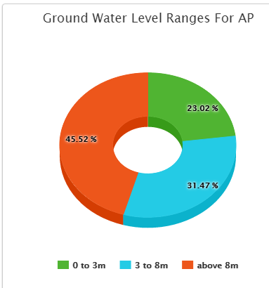
Real Time Data Analysis with Historical Data

Slide 14
Groundwater levels Scenario
Fall in water levels from June 1st 2016
WL- 05-11-16
WL-May-2016

Slide 15
World Class Gauging Network for Hourly monitoring
Measure and Report on Real Time
1168 Automatic Weather Stations at 10 Km X 10 Km resolution aids in Cyclone and Flood Early Warning
Near real time Drought Monitoring
431 Automatic Rain Gauges in Urban areas at 2 Km X 2 Km resolution to manage Urban Flooding
94 River Gauges in 72 river basins - Monitors water level - Helps in Water and Flood Management
76 Reservoir Level Recorders for Monitoring Reservoir Water Levels - for Efficient Water Management
1254 Real Time Automatic Piezometers :
Monitor Ground Water Stress and Poor Quality Areas. Prioritize recharge to bring Ground water 3 to 8 m below Ground Level
Net Recharge of 100 TMC to Ground Water Resource from May 2015-May 2016
Data from surface and ground water resources and dense resolution rainfall measurements are effectively used for water budgeting

Slide 16
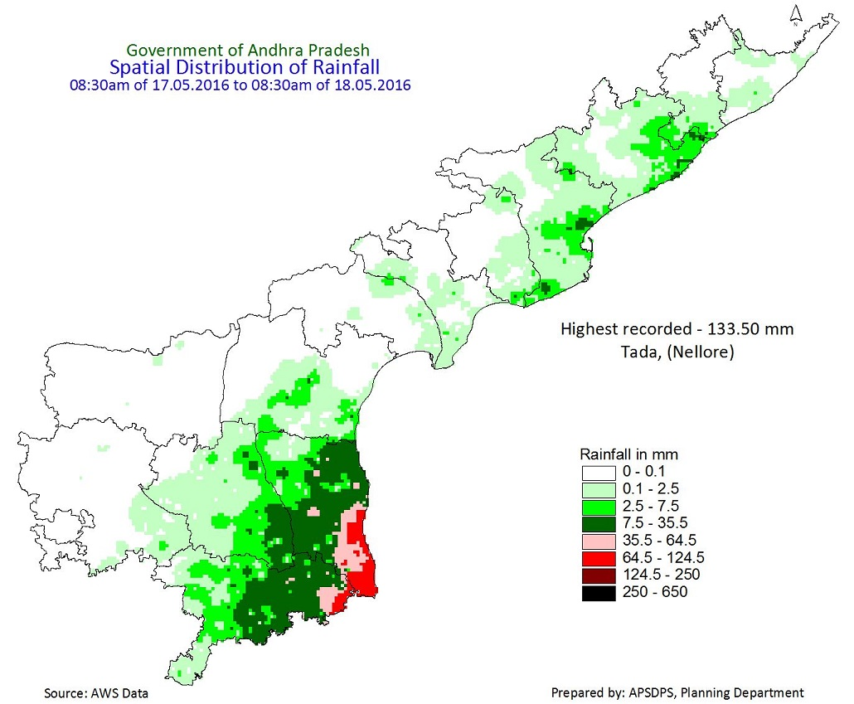
Mapping of Surface and Ground Water status Daily / Weekly / Monthly /
Seasonal for better decision making
and management
Ground Water Levels as on 5.11.2016
24x7 Data Centre for Digital
Data Dissemination-
SMS, Email, Web Service
High resolution daily rainfall
Some out comes

Slide 17
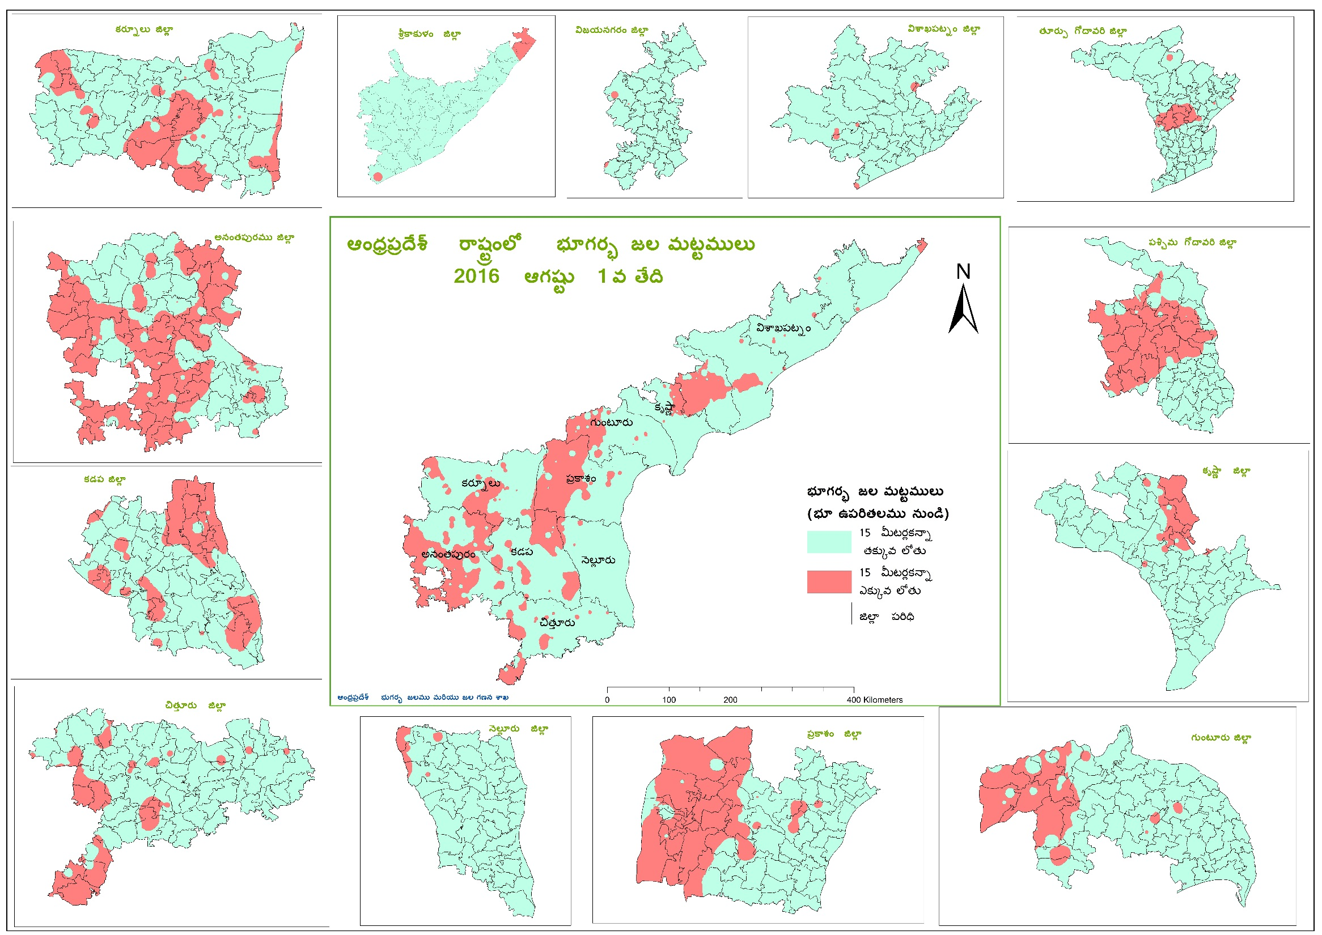
Areas with water levels deeper than 15 meters
for water conservation plans
GW level below ground level
< 15m.
> 15m.

Slide 18
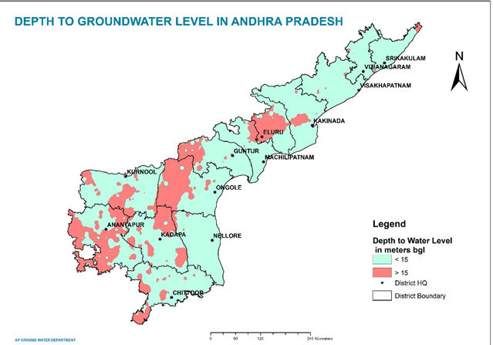
Action Plan for increasing the groundwater recharge
Areas with Groundwater levels deeper than 15.0 meters from ground level
As per the instructions of the Hon’ble Chief Minister, analyzed the groundwater levels data and identified 187 mandals out of the total 670 mandals in the state are having the groundwater levels deeper than 15.0 meters from ground level
District | No. of Mandals with groundwater level deeper than 15.0m. From ground level
Srikakulam | 2
Vizianagaram | 1
Vishakapatnam | 4
East Godavari | 10
West Godavari | 16
Krishna | 9
Guntur | 12
Prakasam | 21
Nellore | 3
Chittoor | 23
YSR Kadapa | 21
Anantapuramu | 45
Kurnool | 20
Grand Total | 187
District wise details along with the groundwater level maps are furnished to the line departments and district administration for preparing suitable action plans to improve the water levels in these areas by Nov-2016

Slide 19
Promotion of Conjunctive use &
New bore wells in Command areas
NTR Jala Siri II
Promoting conjunctive use of groundwater and surface water in a big way
Identified, feasibility of about 2.0 lakh bore wells in Command and high rainfall areas of North Coastal districts.
Implemented a conjunctive use project, where in constructing about 1.24 lakh new bore wells under NTR Jala Siri-II, for small and marginal farmers.
The objective is to utilize the dynamically rechargeable groundwater resources where the groundwater development is under “SAFE” category and create an additional ayacut of about 6.0 lakh acres in the state

Slide 20
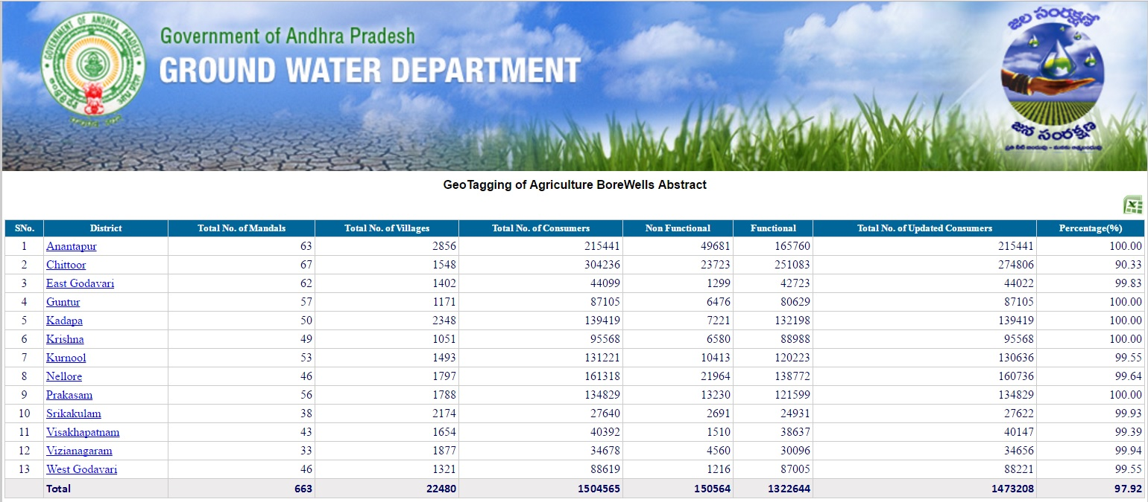
New Initiative for sustainable GW development and management
Link to Bore Wells Geo-tagging
Out of the 15.045 lakh agriculture bore wells, Geo-tagging has been completed for 14.73 lakh bore wells and the balance will be completed very soon

Slide 21
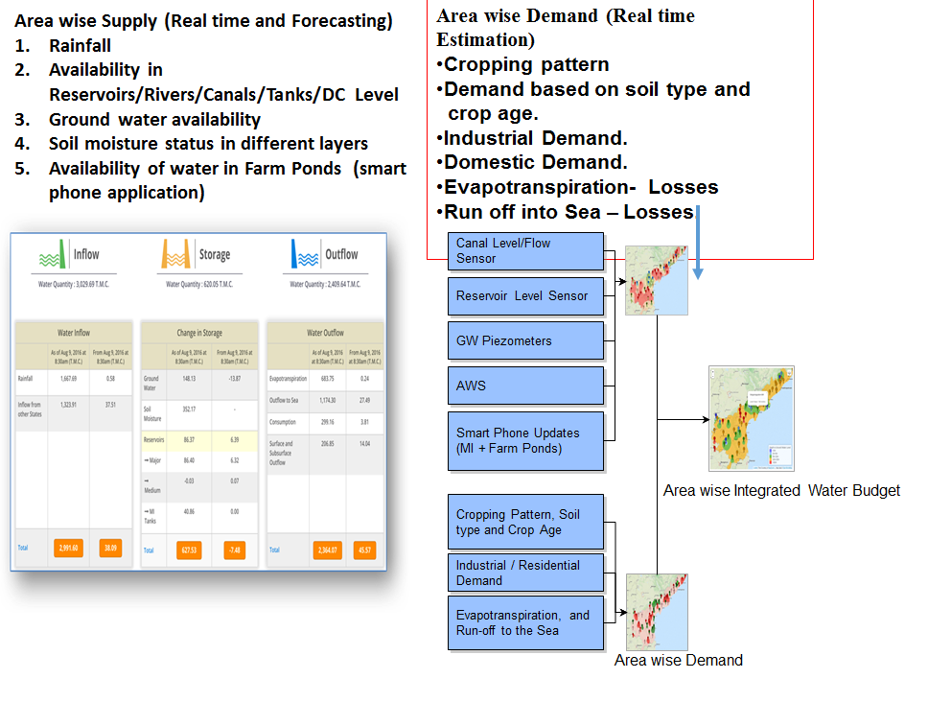
WATER AUDIT ON REAL TIME BASIS

Slide 22
THANK YOU

